Slide 1

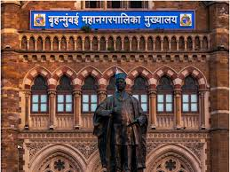
BMC!?

Slide 3
Offering
Customers
Infrastructure

Slide 4
Business Model Canvas
What Activities and Resources are important but not aligned with what’s uniquely strategy for you?
What’s outside of your business type?
Could partners do some of those? Why? Which?
What specific key activities are necessary to deliver our value proposition? What activities set our company apart from others?
Production, Problem Solving, Platform/Network
What value do we deliver to the customer?
Which one of our customer’s problems are we helping to solve?
What is unique about our Value Propositions and why does your customer prefer them to their Current Alternatives?
How does the customer interact with you through the sales and product lifecycle?
Can the Value Proposition be delivered to the Customer this way?
Is there a premium support product you need to create?
Identify who is our value proposition targets.
Who are our most important customers?
What are they like?
What do they need?
What do they enjoy?
Key Partners
Key Activities
Value Propositions
Customer Relationship
Customer Segments
What Key Resources do our Value Propositions require? Our Distribution Channels? Customer Relationships Revenue Streams?
Physical, Intellectual (brand patents, copyrights, data), Human, Financial
How do we deliver our value proposition?
How are we reaching them now?
How are our Channels integrated?
Which ones work best?
Which ones are most cost-efficient?
Key Resources
Channels
What are the most important costs inherent in our business model?
Which Key Resources are most expensive?
Which Key Activities are most expensive?
For what value are our customers really willing to pay?
For what do they currently pay?
How are they currently paying? How would they prefer to pay?
How much does each Revenue Stream contribute to overall revenues?
Cost Structure
Revenue Stream

Slide 5
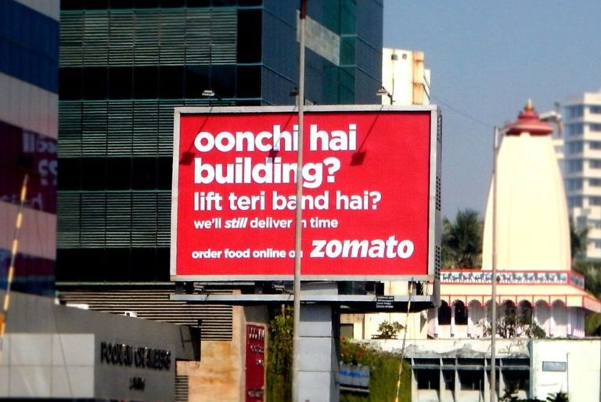

Slide 6

Business Model Canvas
Food Lovers
Busy Professionals
Restaurant owners
Key Partners
Key Activities
Value Propositions
Customer Relationship
Customer Segments
Key Resources
Channels
Cost Structure
Revenue Stream

Slide 7
Business Model Canvas
Convenience
Variety: Access to a vast selection of restaurants.
Quality
Transparency: Detailed information about restaurants and menu items.
Delivery and pickup
Reviews and ratings
Food Lovers
Busy Professionals
Restaurant owners
Key Partners
Key Activities
Value Propositions
Customer Relationship
Customer Segments
Key Resources
Channels
Cost Structure
Revenue Stream

Slide 8
Business Model Canvas
Convenience
Variety: Access to a vast selection of restaurants.
Quality
Transparency: Detailed information about restaurants and menu items.
Delivery and pickup
Reviews and ratings
Food Lovers
Busy Professionals
Restaurant owners
Key Partners
Key Activities
Value Propositions
Customer Relationship
Customer Segments
Website
Mobile app
Social Media
Key Resources
Channels
Cost Structure
Revenue Stream

Slide 9
Business Model Canvas
Convenience
Variety: Access to a vast selection of restaurants.
Quality
Transparency: Detailed information about restaurants and menu items.
Delivery and pickup
Reviews and ratings
Customer Support
Rewards and incentives
Personalized Recommendations
User Feedback
Food Lovers
Busy Professionals
Restaurant owners
Key Partners
Key Activities
Value Propositions
Customer Relationship
Customer Segments
Website
Mobile app
Social Media
Key Resources
Channels
Cost Structure
Revenue Stream

Slide 10
Business Model Canvas
Convenience
Variety: Access to a vast selection of restaurants.
Quality
Transparency: Detailed information about restaurants and menu items.
Delivery and pickup
Reviews and ratings
Customer Support
Rewards and incentives
Personalized Recommendations
User Feedback
Food Lovers
Busy Professionals
Restaurant owners
Key Partners
Key Activities
Value Propositions
Customer Relationship
Customer Segments
Website
Mobile app
Social Media
Key Resources
Channels
Commission on orders
Advertisements displayed on the app and website
Subscription services
Cost Structure
Revenue Stream

Slide 11
Business Model Canvas
Restaurant onboarding
Order Processing
Marketing and Promotion
Data Analysis
Delivery Management
Customer Support
Convenience
Variety: Access to a vast selection of restaurants.
Quality
Transparency: Detailed information about restaurants and menu items.
Delivery and pickup
Reviews and ratings
Customer Support
Rewards and incentives
Personalized Recommendations
User Feedback
Food Lovers
Busy Professionals
Restaurant owners
Key Partners
Key Activities
Value Propositions
Customer Relationship
Customer Segments
Website
Mobile app
Social Media
Key Resources
Channels
Commission on orders
Advertisements displayed on the app and website
Subscription services
Cost Structure
Revenue Stream

Slide 12
Business Model Canvas
Restaurant onboarding
Order Processing
Marketing and Promotion
Data Analysis
Delivery Management
Customer Support
Convenience
Variety: Access to a vast selection of restaurants.
Quality
Transparency: Detailed information about restaurants and menu items.
Delivery and pickup
Reviews and ratings
Customer Support
Rewards and incentives
Personalized Recommendations
User Feedback
Food Lovers
Busy Professionals
Restaurant owners
Key Partners
Key Activities
Value Propositions
Customer Relationship
Customer Segments
Technology Platform
Delivery Network
Restaurant partnerships
Data and Analytics
Website
Mobile app
Social Media
Key Resources
Channels
Commission on orders
Advertisements displayed on the app and website
Subscription services
Cost Structure
Revenue Stream

Slide 13
Business Model Canvas
Restaurants
Delivery Partners
Technology Providers
Marketing Partners
Payment gateways
Restaurant onboarding
Order Processing
Marketing and Promotion
Data Analysis
Delivery Management
Customer Support
Convenience
Variety: Access to a vast selection of restaurants.
Quality
Transparency: Detailed information about restaurants and menu items.
Delivery and pickup
Reviews and ratings
Customer Support
Rewards and incentives
Personalized Recommendations
User Feedback
Food Lovers
Busy Professionals
Restaurant owners
Key Partners
Key Activities
Value Propositions
Customer Relationship
Customer Segments
Technology Platform
Delivery Network
Restaurant partnerships
Data and Analytics
Website
Mobile app
Social Media
Key Resources
Channels
Commission on orders
Advertisements displayed on the app and website
Subscription services
Cost Structure
Revenue Stream

Slide 14
Business Model Canvas
Restaurants
Delivery Partners
Technology Providers
Marketing Partners
Payment gateways
Restaurant onboarding
Order Processing
Marketing and Promotion
Data Analysis
Delivery Management
Customer Support
Convenience
Variety: Access to a vast selection of restaurants.
Quality
Transparency: Detailed information about restaurants and menu items.
Delivery and pickup
Reviews and ratings
Customer Support
Rewards and incentives
Personalized Recommendations
User Feedback
Food Lovers
Busy Professionals
Restaurant owners
Key Partners
Key Activities
Value Propositions
Customer Relationship
Customer Segments
Technology Platform
Delivery Network
Restaurant partnerships
Data and Analytics
Website
Mobile app
Social Media
Key Resources
Channels
Technology costs
Marketing and advertising costs
Delivery costs
Customer support costs
Commission on orders
Advertisements displayed on the app and website
Subscription services
Cost Structure
Revenue Stream

